Slide 1

Crunching Big Data
big
DATA
Mihai Budiu
Microsoft Research, Silicon Valley
September 27, 2011

Slide 2
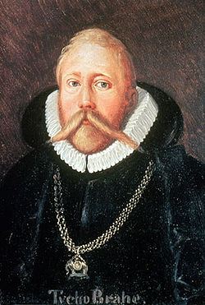
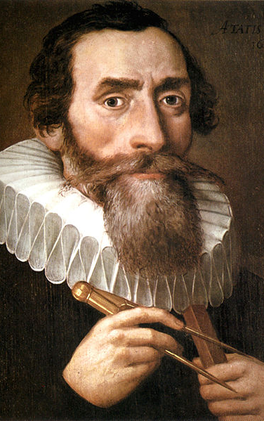
500
YEARS AGO
Tycho Brahe 1546 – 1601
Johannes Kepler
1571 – 1630
Notes:
Images from Wikipedia
Tycho: Danish origin, royal astronomer for Rudolph II, the Holy Roman Emperor in Prague, last of the “naked eye” major astronomers
Kepler: German, born prematurely, sickly, poor eyesight, excellent mathematician

Slide 3
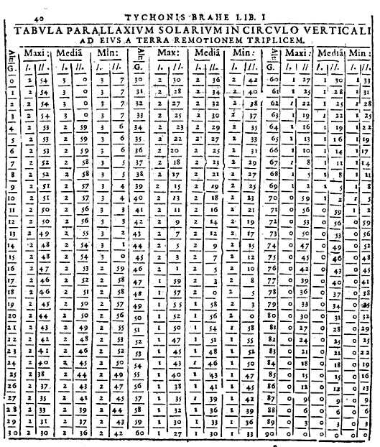
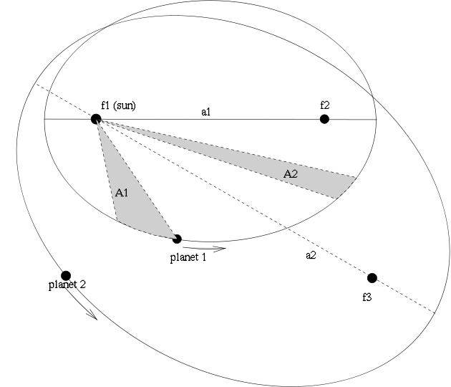
The laws of
PLANETARY MOTION
Tycho’s measurements
Kepler’s laws
Notes:
Left image from Google Books.
Right image from Wikipedia.

Slide 4
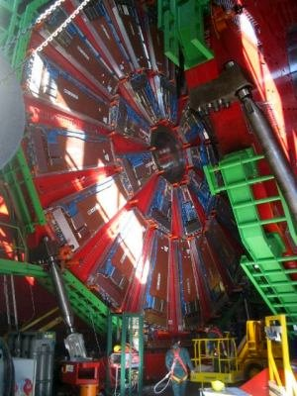
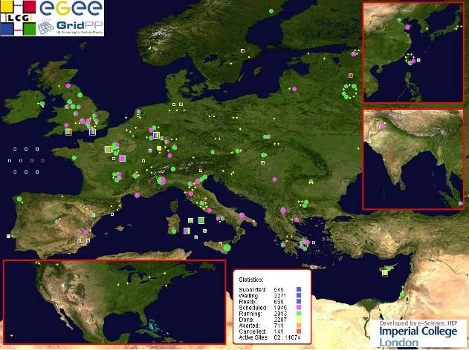
THE LARGE HADRON COLLIDER
LHC Grid: 200K computing cores
15 PB/year
Notes:
Left image from Wikipedia.

Slide 5
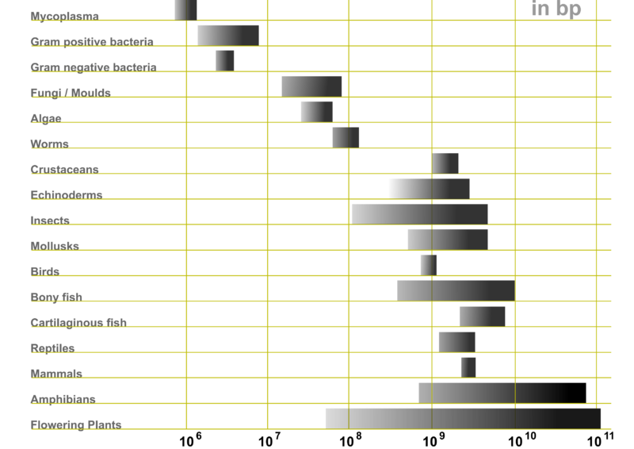
genetic CODE
10⁶
10⁷
10⁸
10⁹
10¹⁰
10¹¹
MYCOPLASMA
GRAM POSITIVE BACTERIA
GRAM NEGATIVE BACTERIA
FUNGI/MOULDS
ALGAE
WORMS
CRUSTACEANS
ECHINODERMS
INSECTS
MOLLUSKS
BIRDS
BONY FISH
CARTILAGINOUS FISH
REPTILES
MAMMALS
AMPHIBIANS
FLOWERING PLANTS

Slide 6
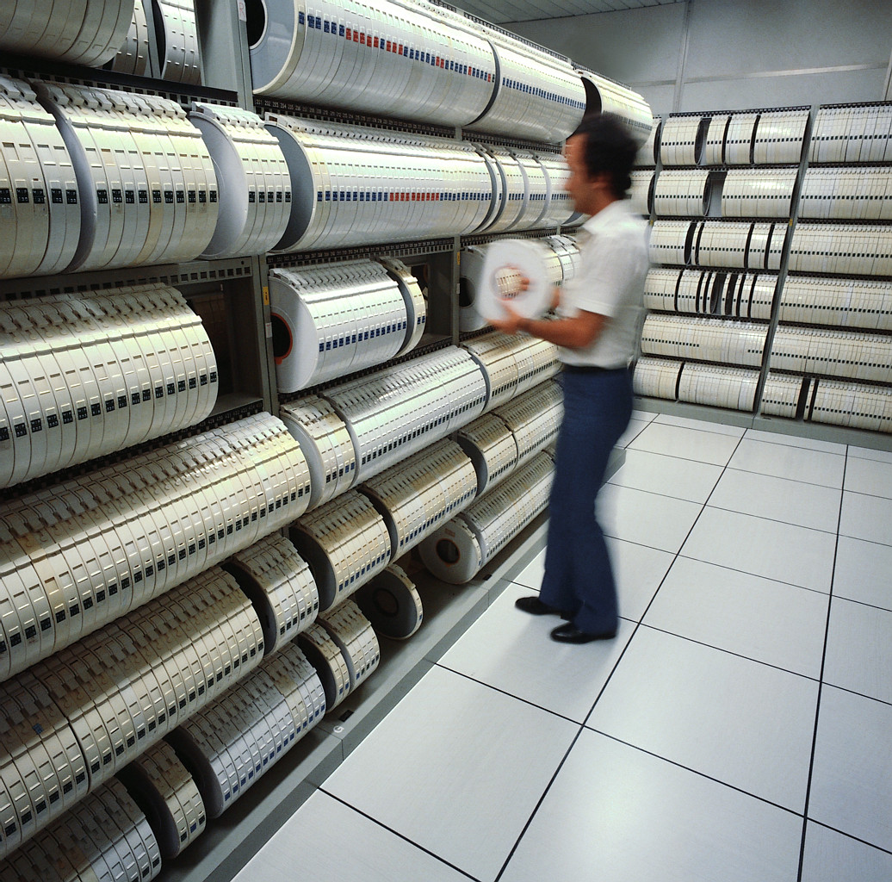
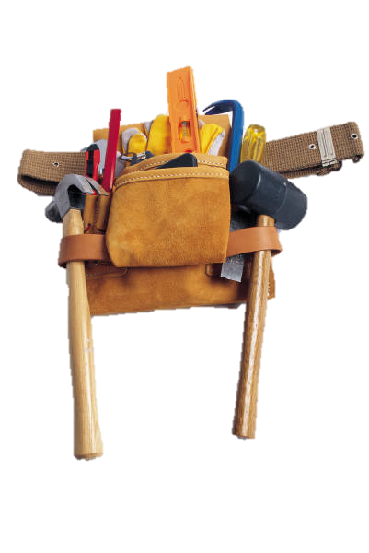
big DATA

Slide 7


big COMPUTERS

Slide 8

some
TRUE STORIES

Slide 9

>4B queries/month [comscore]

Slide 10
Large-Scale Analytics Engine
Distributed Execution: Dryad

Slide 11
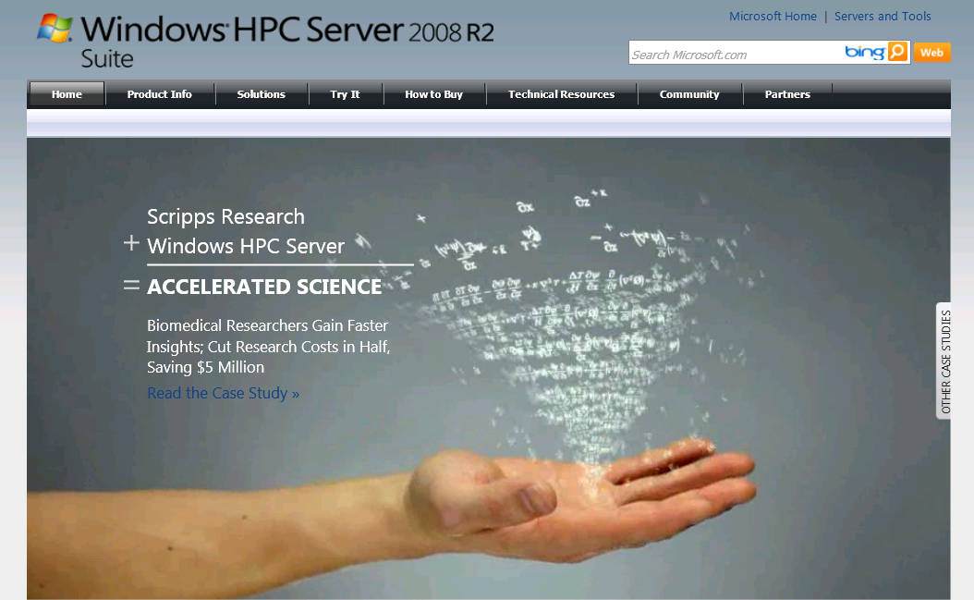
Cluster Programming: DryadLINQ
Distributed Execution: Dryad
Distributed Storage: TidyFS

Slide 12
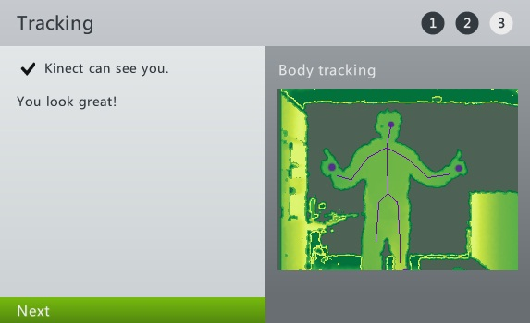

Slide 13
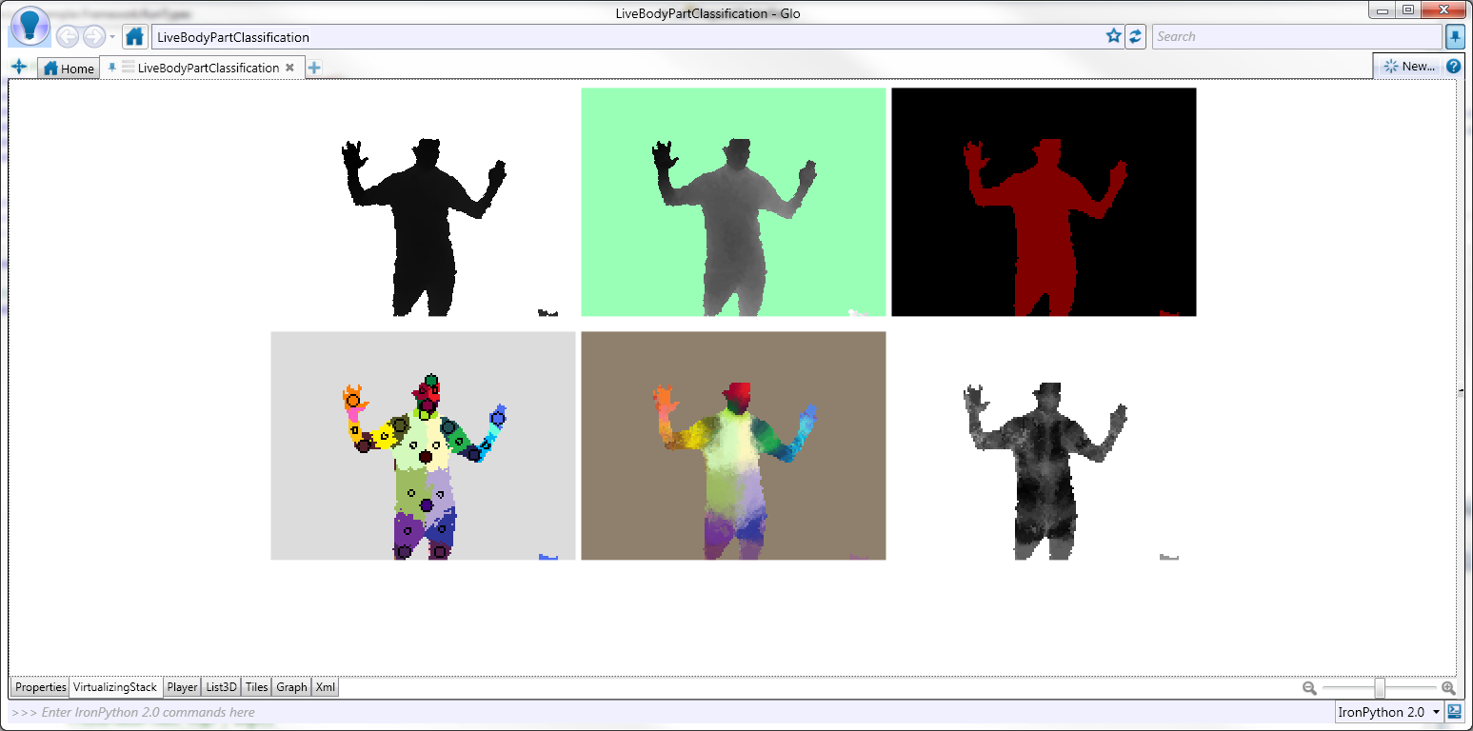
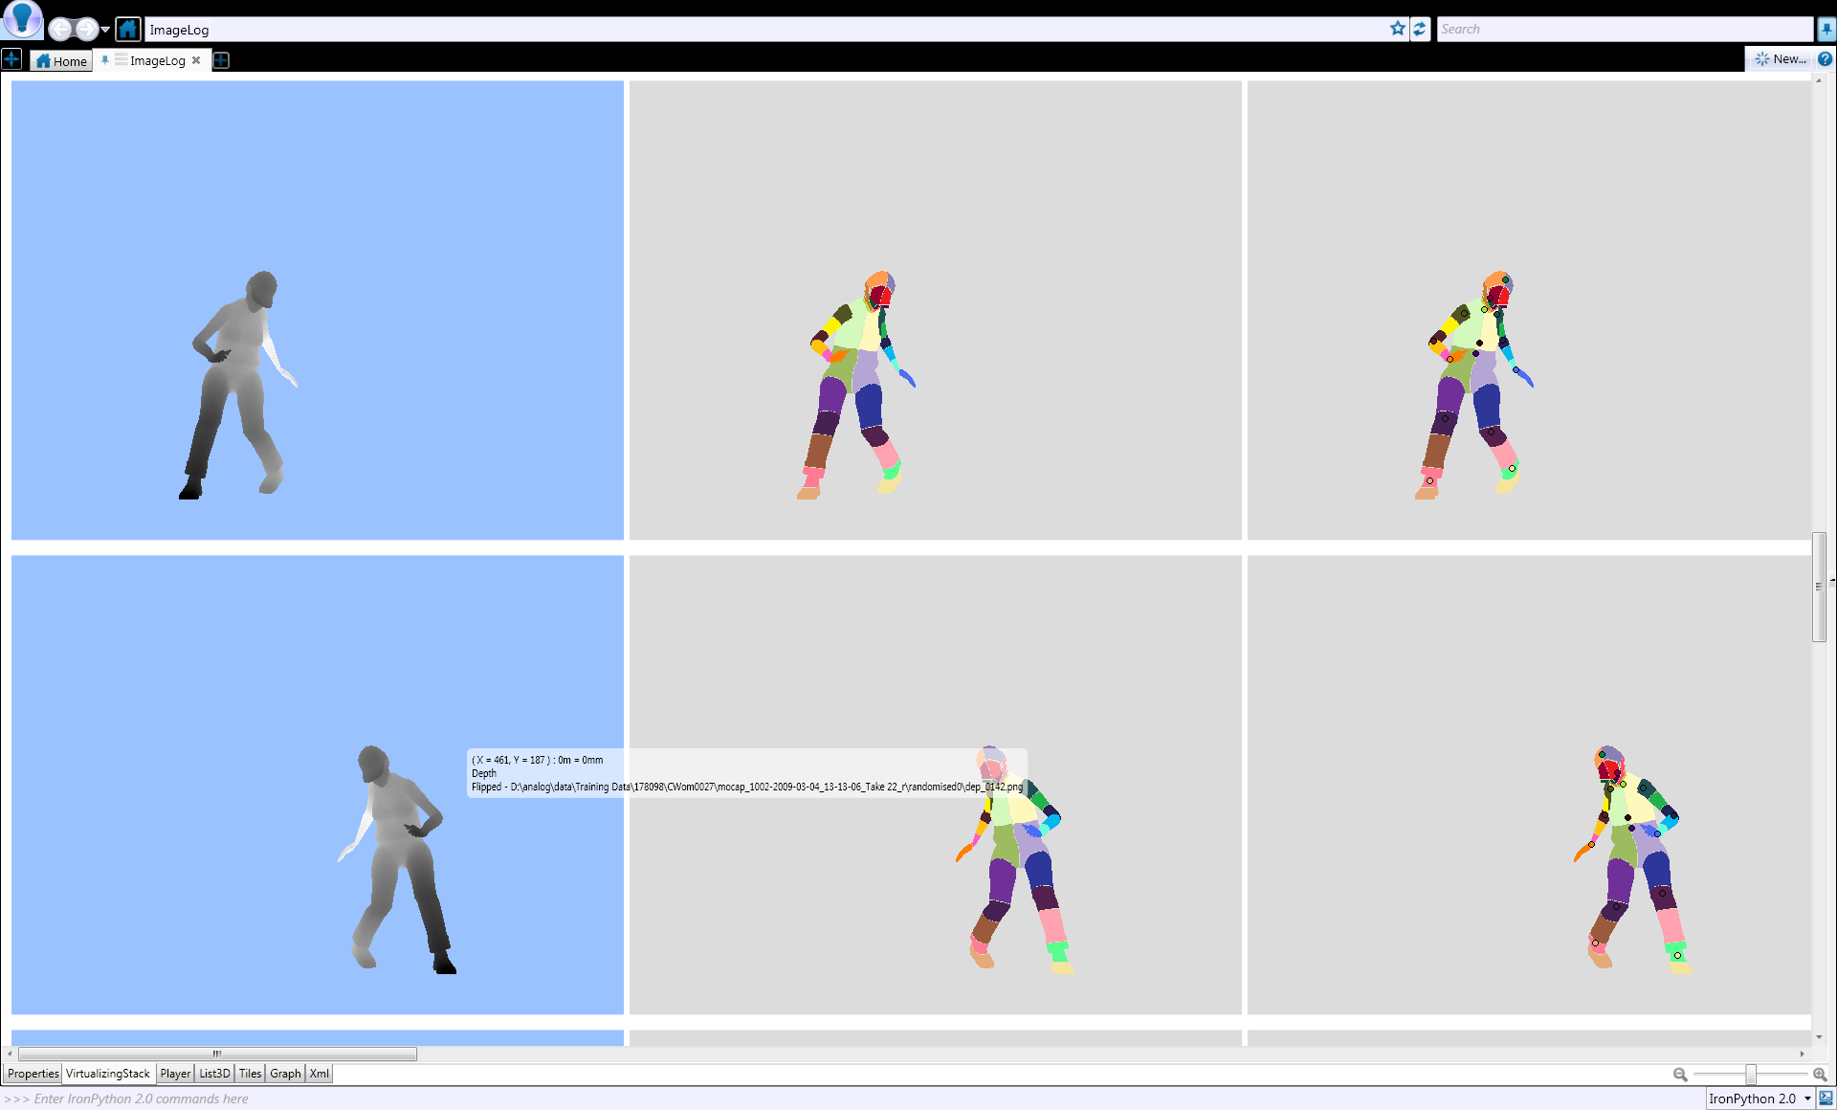

LEARN FROM DATA
Application: Decision forests
Library: Machine learning
Training examples
Programming: DryadLINQ
Distributed Execution: Dryad
Machine learning
Classifier

Slide 14
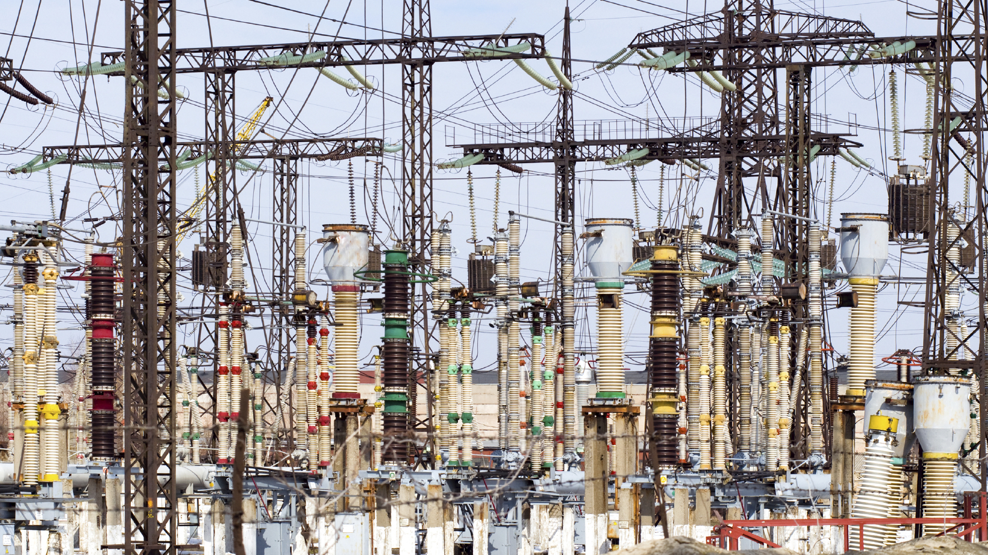

CONCLUSION

Slide 15
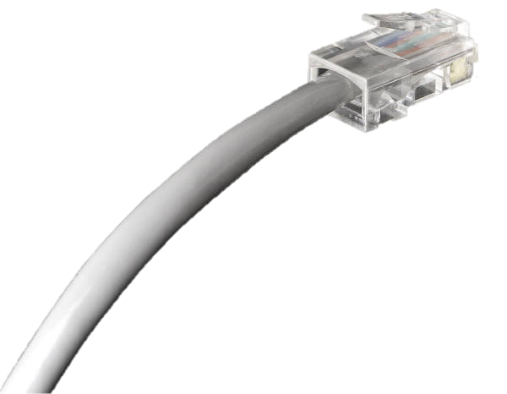
CONCLUSION

